Slide 1



COST OF HIRING ANALYSIS.
Group 3
Michael Banks Prathyusha Godavarthy
Darius Stallone Praneeth Voruganti

Slide 2
AGENDA
Introduction
Background
Objective
Our Data
Our Analysis
Results

Slide 3







INTRODUCTION
Sourcer
Marketplace
Post
a Job
Source
a
Position
Programmatic
Pay Per Hire & Split Fee
Customer Wants to
Reporting
Understand Performance
OFCCP
Comply
with
Regulations

Slide 4
BACKGROUND
Who are we?
Jobtarget.com is a small to medium sized HR technology company.
What do we specialize in?
Specializes in vertical integration of job advertising technologies to enable customers to seamlessly connect and post job advertisements.
Where are we based ?
The company is based in Stamford Connecticut and has employees in the United States as well as the Philippines.

Slide 5

Using the real-time data from Jobtarget.com, we are performing analysis on Medical and Nursing industries, focusing on one key metric count of hire.
We are trying to identify the job and performance of the clients related to the job advertisement and hiring effectiveness.
OBJECTIVE
Market Place
Type of ad
Programmatic

Slide 6

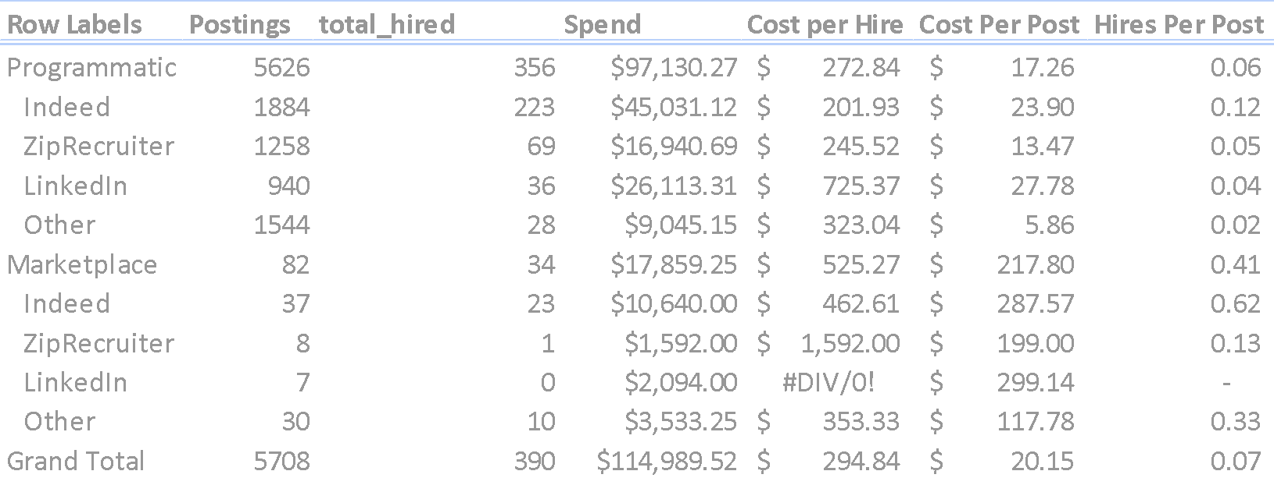
SUMMARY OF OUR DATA
A job advertisement through Programmatic will post a job to all major Job Sites until the budget for that job is exhausted or at the end of 30 days, which every comes first. The budget per job is set by the customer with guidance from JobTarget.com.
Programmatic job postings are fully automated, requiring less customer oversight, and delivers higher long term customer retention rates when compared to customers who purchase Marketplace job advertisements.

Slide 7

Data Dictionary
Total_hires= count of jobseekers hired per posting
Spend = The amount of money spent on a Job Advertisement
Product_id = 1 for Marketplace (CPM duration based advertisement product), 0 for Programmatic (PPC advertisement product)
JobSite Publisher: Site_group_id:
Site_group_id: 1 for Indeed, 0 for ZipRecuriter,Linkedin, and Other
Site_group_id: 2 for ZipRecruiter, 0 for Indeed,Linkedin, and Other
Site_group_id: 3 for LinkedIn, 0 for ZipRecuriter,Indeed, and Other
Site_group_id: 4 for Other, 0 for ZipRecuriter,Linkedin, and Indeed

Slide 8
OUR MODEL EQUATION
Full Model:
Ln(Total_hires) = β0 + β1 (Spend) + β2 (Product_id:1) + β3 (ZipRecruiter:2) + β4 (LinkedIn:3) + β5(Other:4) + β6 (Spend x Product_id:1) + β7 (Spend x ZipRecruter:2) + β8 (Spend x LinedIn:3) + β9 (Spend x Other:4) + β10 (Product_id:1 x ZipRecruiter:2) + β11 (Product:1 x LinkedIn:2) + β12 (Product_id:1 x Other:4) + Error
We decided to reduce the number of interaction terms because we wanted to focus on the main objective, the highest probability of hires and which advertisement product is better at obtaining hires while accounting for spend.
Since Site Selection is controlled in different ways depending on the product selected we chose to ignore interactions between sites and product.
Revised model: Ln(Total_hires) = β0 + β1 (Spend) + β2 (Product_id:1) + β3 (ZipRecruiter:2) + β4 (LinkedIn:3) + β5(Other:4) + β6 (Spend x Product_id:1) + β7 (Spend x ZipRecruter:2) + β8 (Spend x LinedIn:3) + β9 (Spend x Other:4) + Error

Slide 9
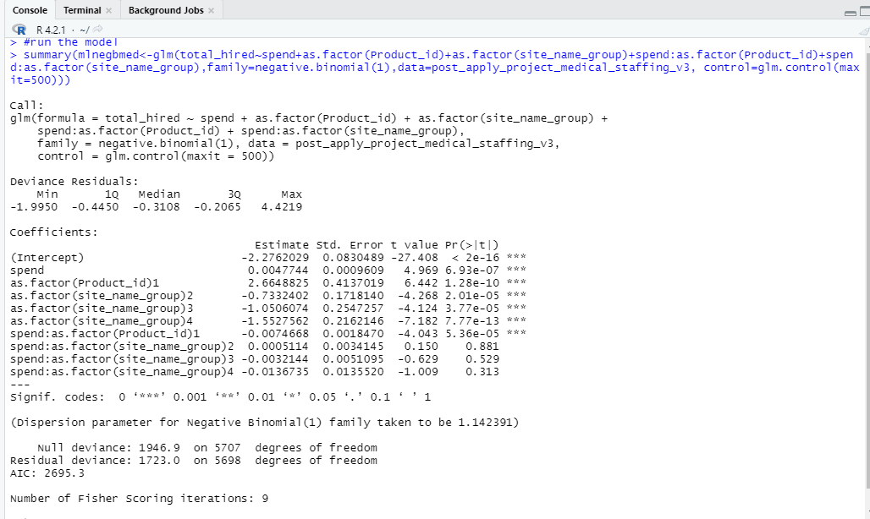
OUR ANALYSIS
Observation:
β0 measures hires for Programmatic
β0+ β2 measures hires for Marketplace
β2 measures the difference in hires between Programmatic and Marketplace
β1 measures the spend effect for programmatic
β1+ β6 measures the spend effect for Marketplace
β6 measures the difference in spend effect between Programmatic and Marketplace
β3 measures the difference in hires between ZipRecruiter and Indeed
β4 measures the difference in hires between LinkedIn and Indeed
β5 measures the difference in hires between Other and Indeed
β7 measures the difference in spend effect between ZipRecruiter and Indeed
β8 measures the difference in spend effect between LinkedIn and Indeed
β9 measures the difference in spend effect between Other and Indeed

Slide 10
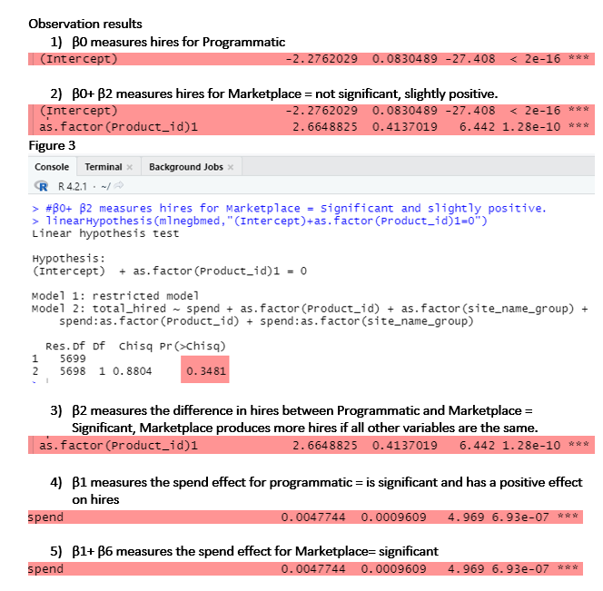
OUR OBSERVATIONS & RESULTS

Slide 11
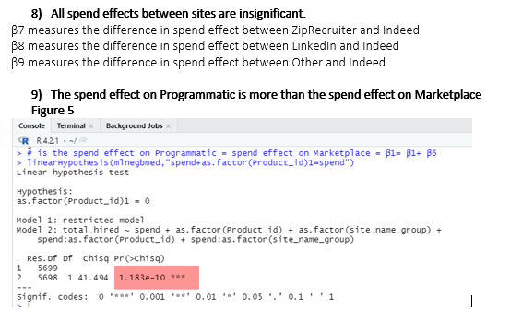
OUR OBSERVATIONS & RESULTS

Slide 12
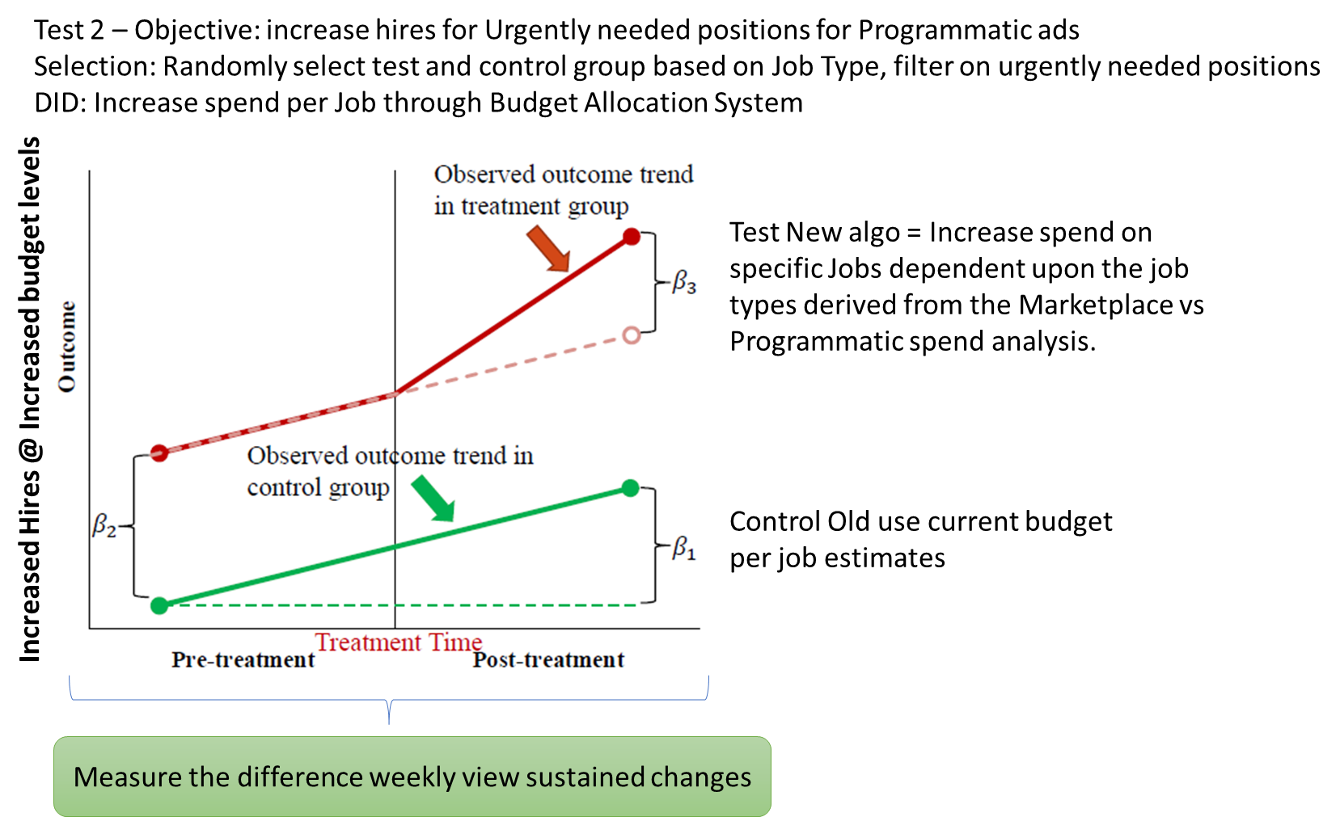
RECOMMENDATIONS

Slide 13
RECOMMENDATIONS

Slide 14
THANK YOU

